Slide 1
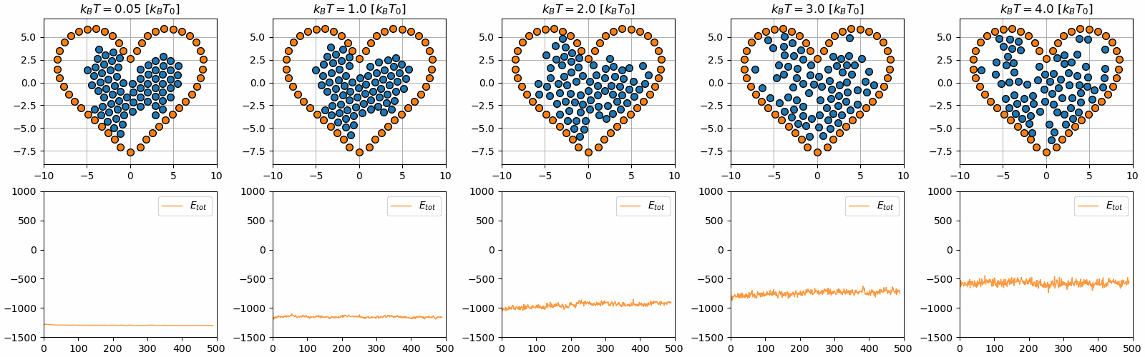
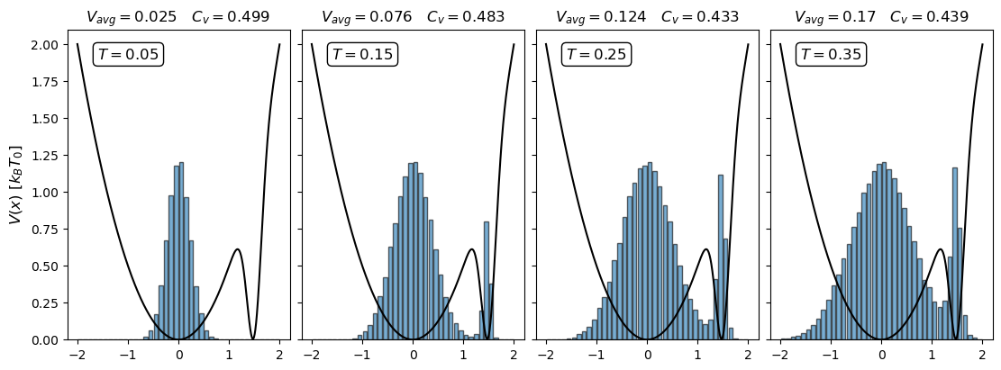
Simulation of temperature

Slide 2
Outline
Goal: Understand how to simulate temperature
Brief summary of statistical physics
Monte Carlo & Metropolis Monte Carlo sampling
Molecular Dynamics simulations (MD-simulations)

Slide 3
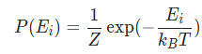
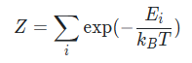
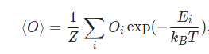
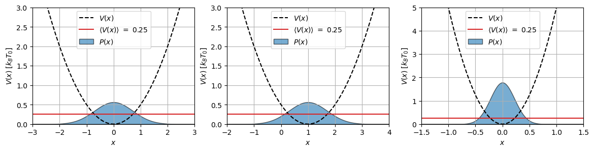
Brief summary of statistical physics
Canonical ensemble → Boltzmann statistics
Hairy integrals → Monte carlo sampling

Slide 4
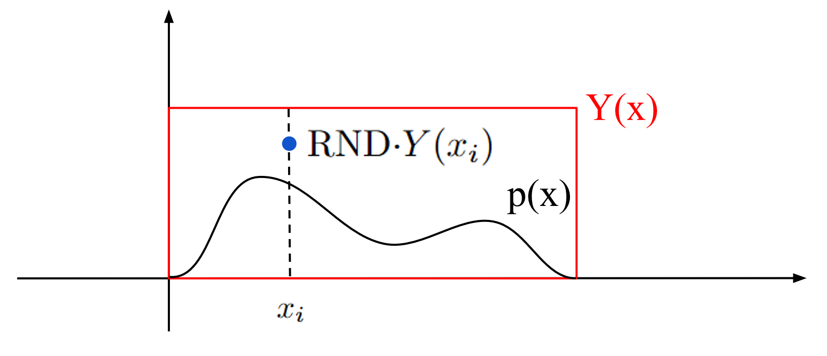
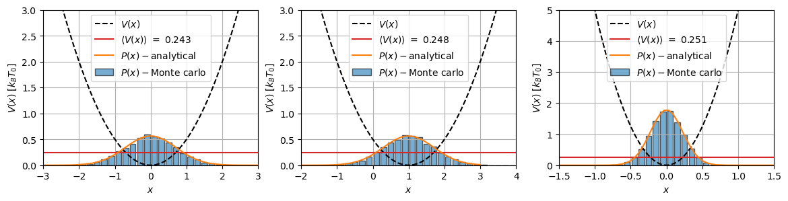
Monte Carlo sampling & Metropolis Monte Carlo sampling
Short comings:
Have to choose Y(x)

Slide 5
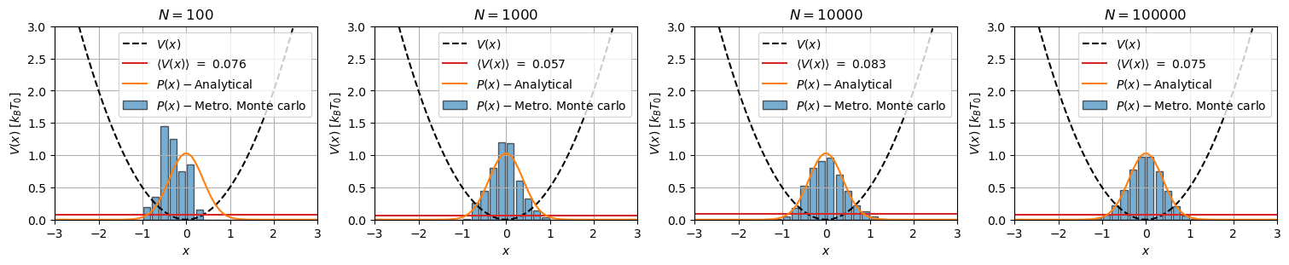
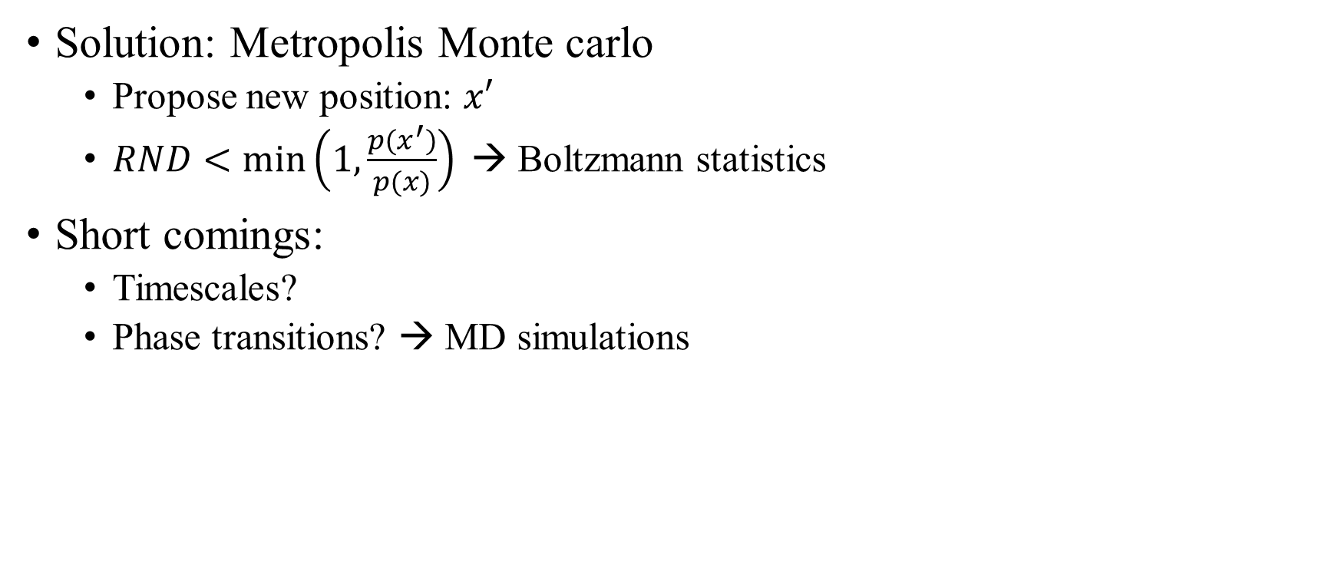
Monte Carlo sampling & Metropolis Monte Carlo sampling
Solution: Metropolis Monte carlo
Propose new position: $x′$
$RND<min\left(1, \frac{p(x^{′})}{p(x)}\right)⁡$→ Boltzmann statistics
Short comings:
Timescales?
Phase transitions? → MD simulations

Slide 6
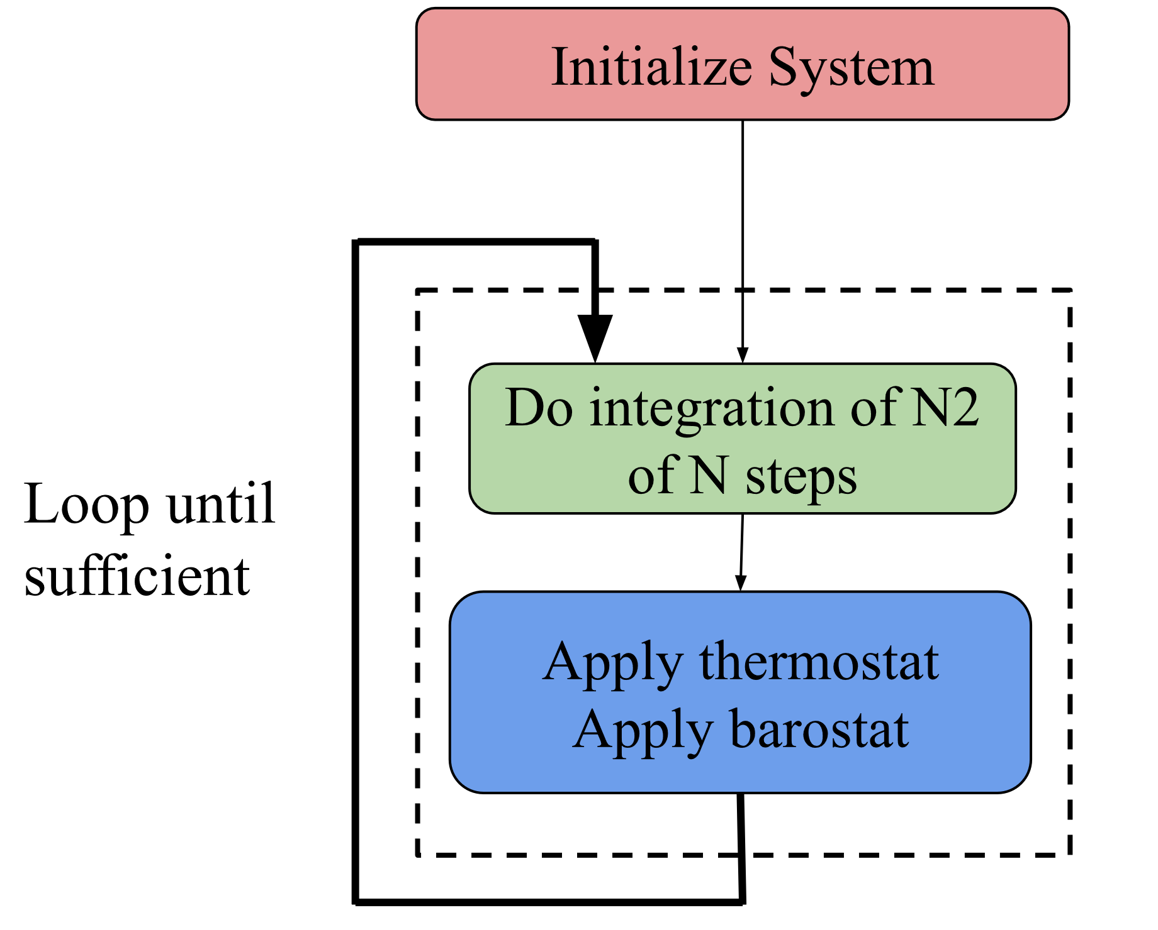
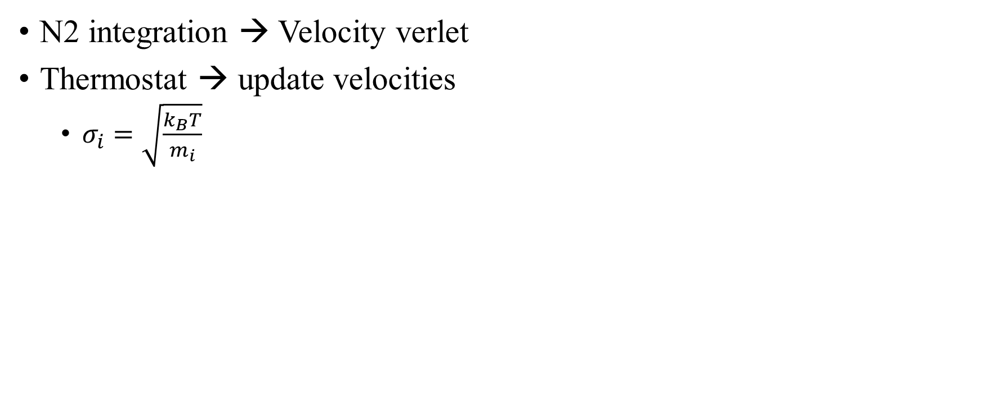
Molecular Dynamics (MD) – Simulations:
N2 integration → Velocity verlet
Thermostat → update velocities
$σ_{i}=\sqrt{\frac{k_{B}T}{m_{i}}}$

Slide 7
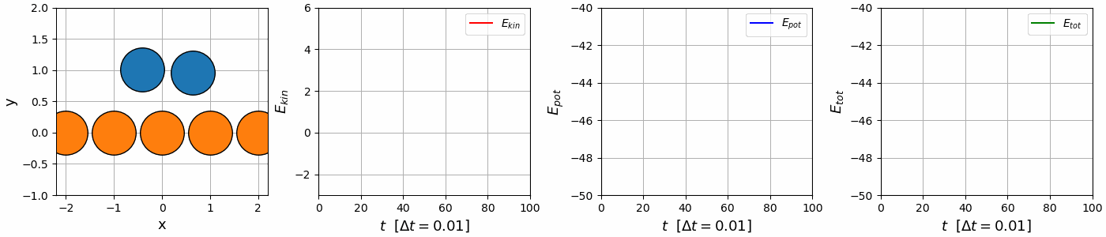
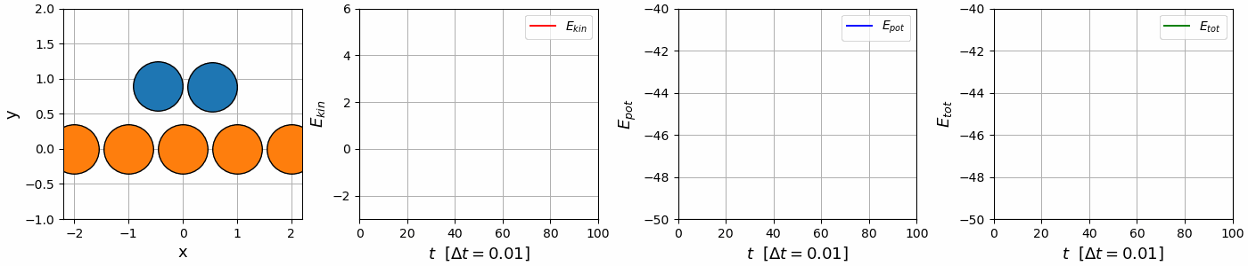
Velocity verlet vs. Euler integration
MD-simulations → Integration of N2 + thermostat
Velocity
verlet
Euler integration

Slide 8
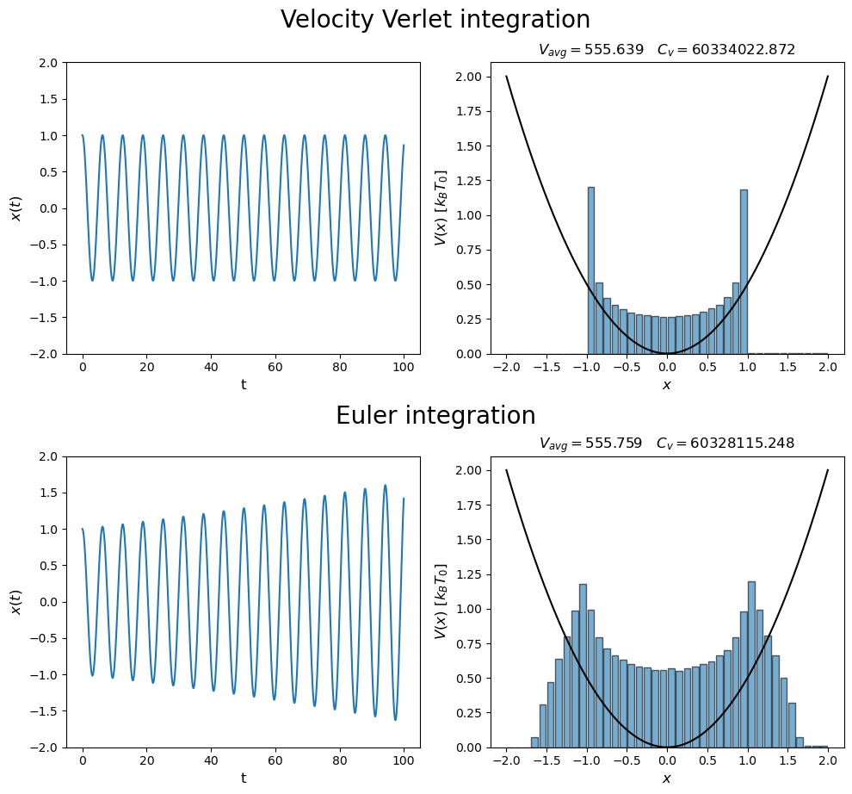
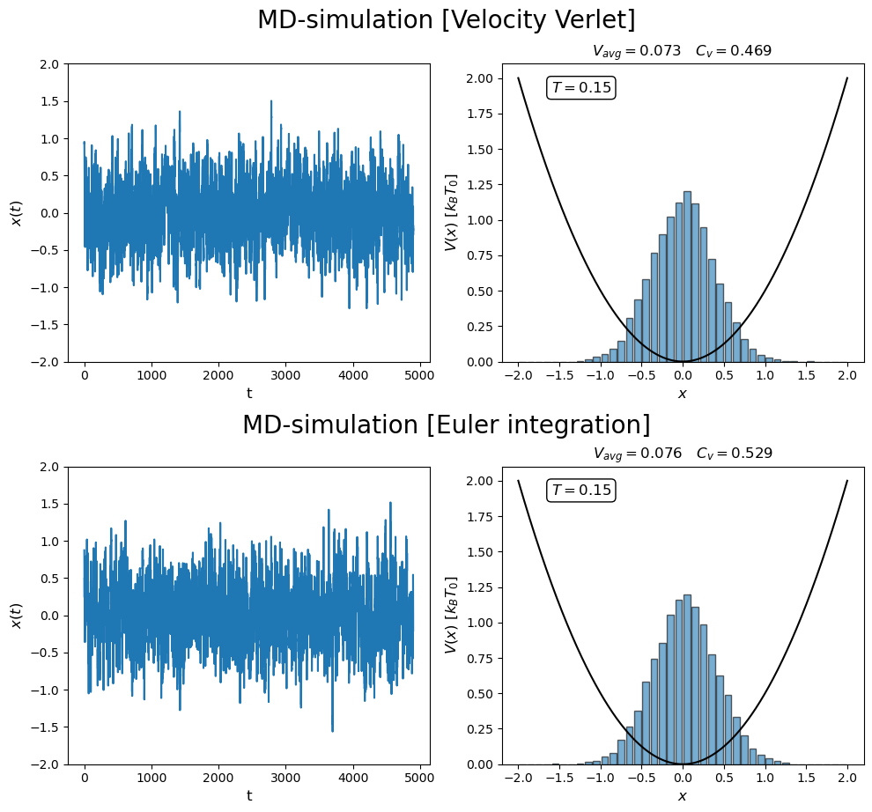
N2 integration + thermostat
Switch on thermostat

Slide 9
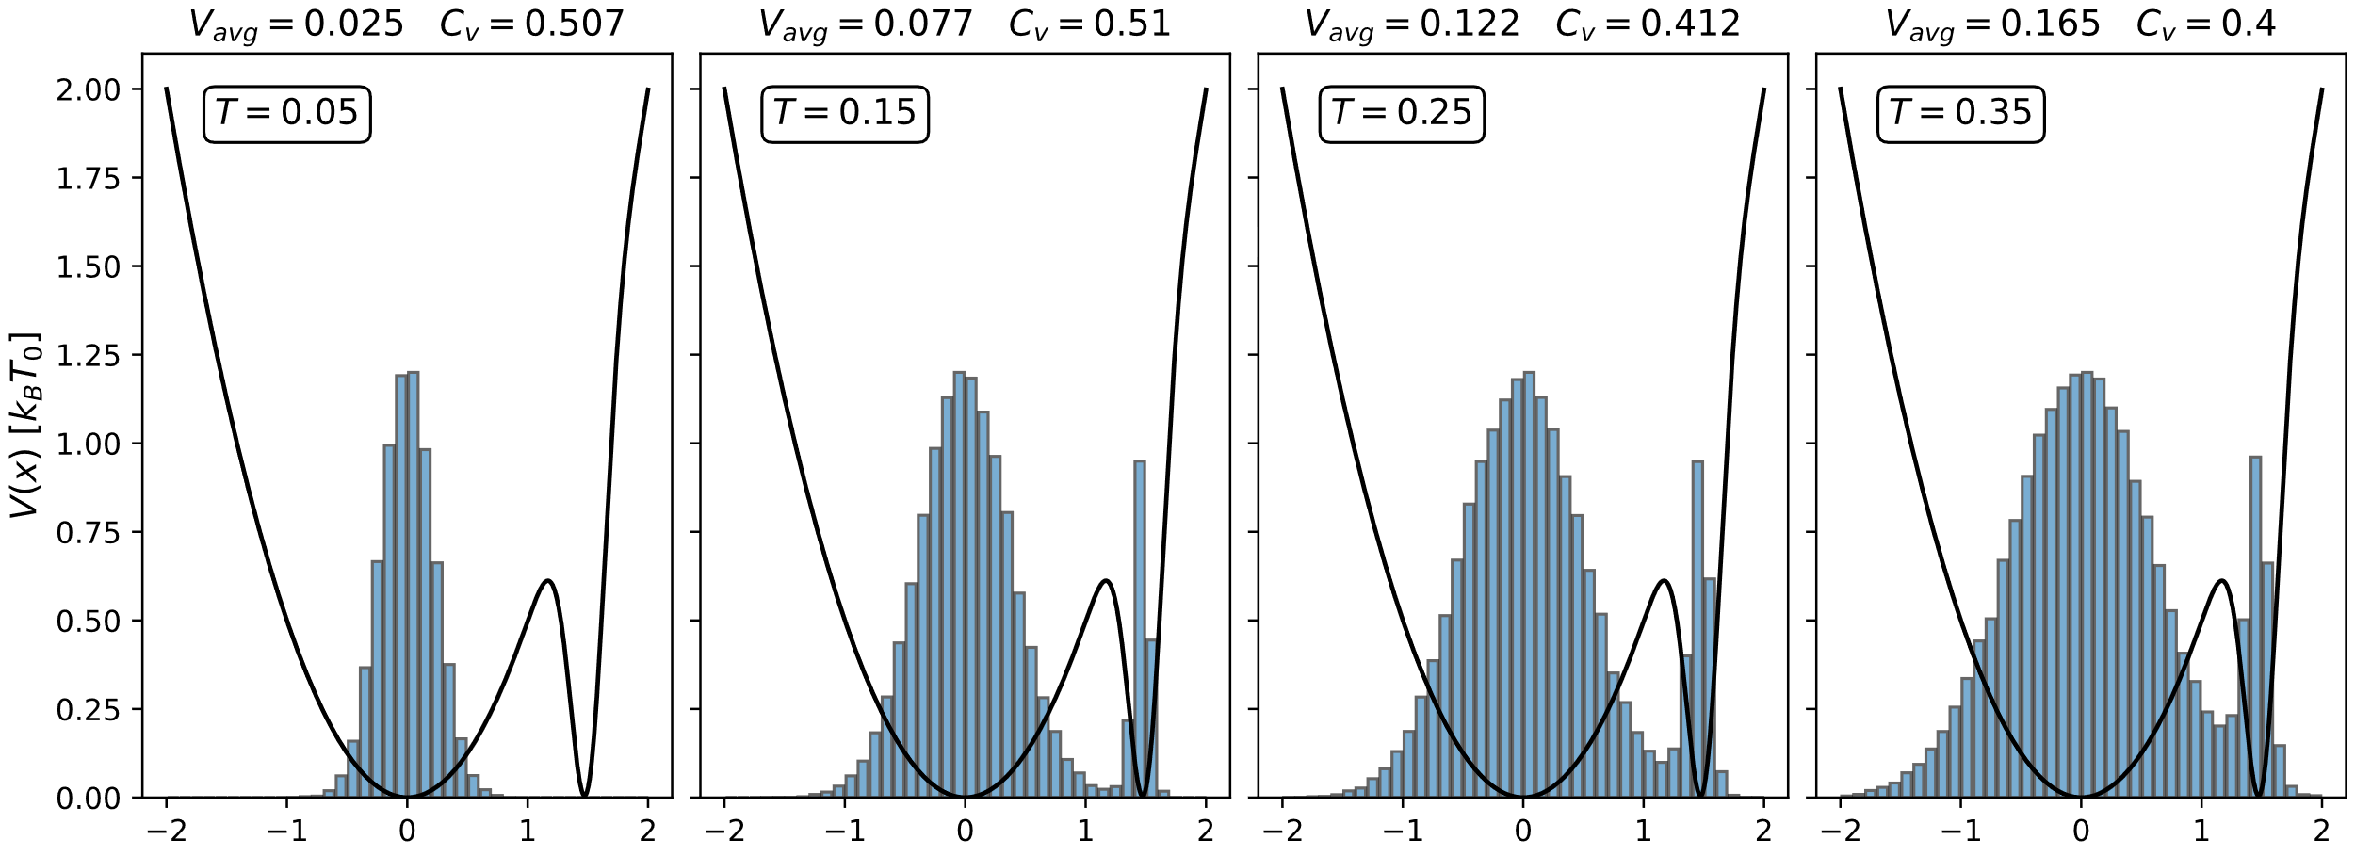
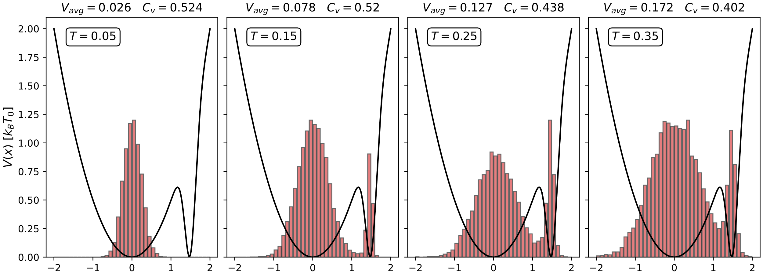
Metropolis Montecarlo vs. MD-simulation
Metropolis Montecarlo
MD-simulations

Slide 10
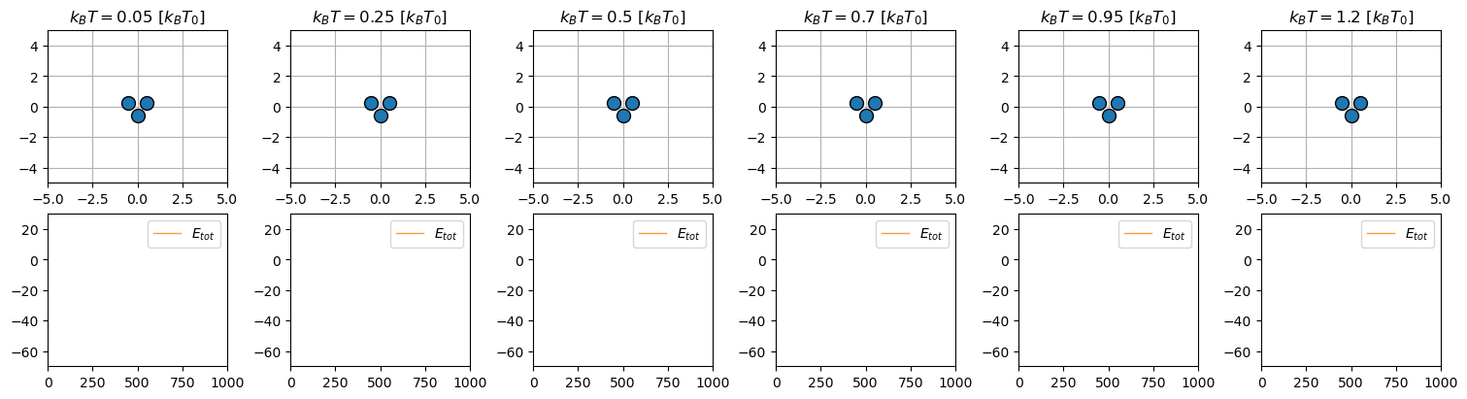
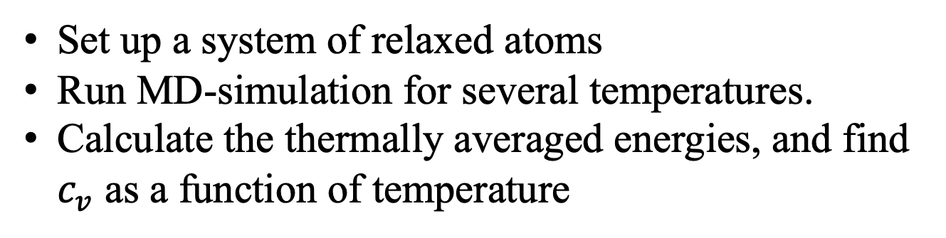
Find phase transition of simple molecule
Set up a system of relaxed atoms
Run MD-simulation for several temperatures.
Calculate the thermally averaged energies, and find $c_{v}$ as a function of temperature

Slide 11
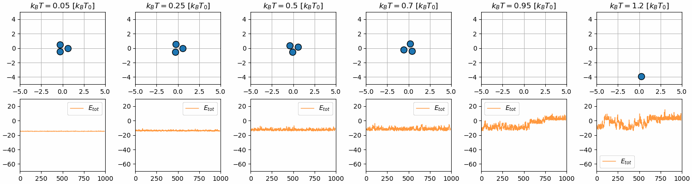
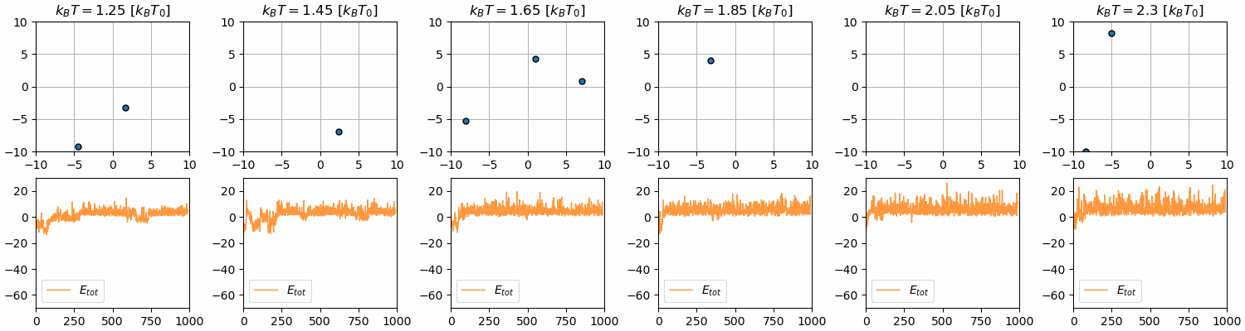
Find phase transition of simple molecule

Slide 12
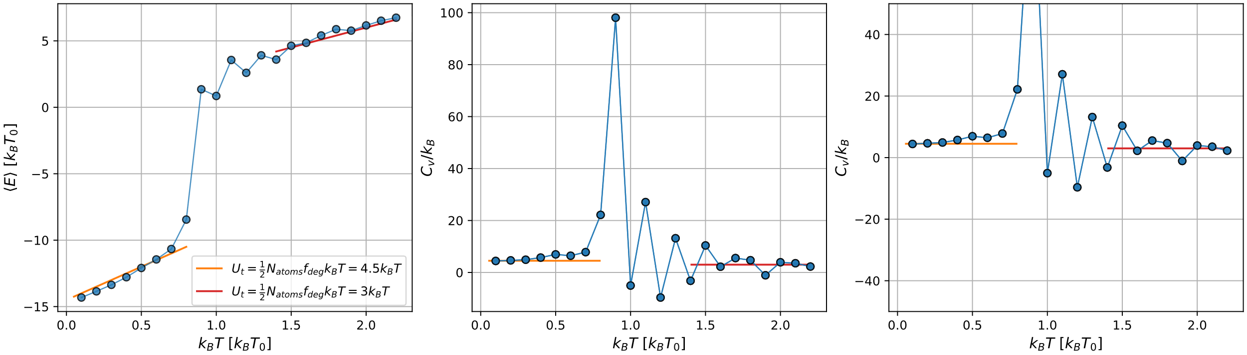
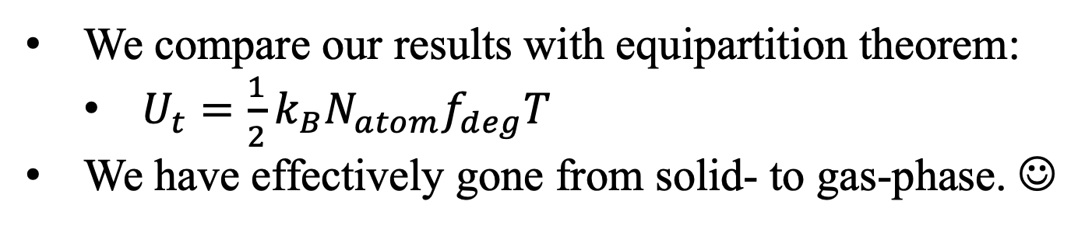
Find phase transition of simple molecule
We compare our results with equipartition theorem:
$U_{t}=\frac{1}{2}k_{B}N_{atom}f_{deg}T$
We have effectively gone from solid- to gas-phase. ☺

Slide 13
Another phenomena: Simulated annealing
Set up relaxed atoms → Heat up → Cool down (slowly)
Hopefully end up in more stable structure

Slide 14
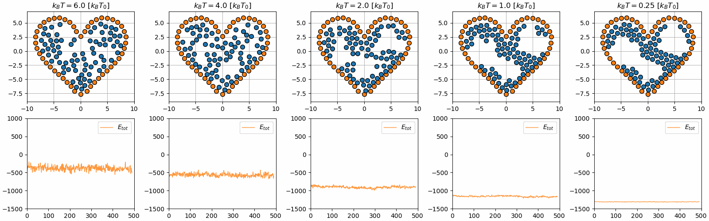

Slide 15
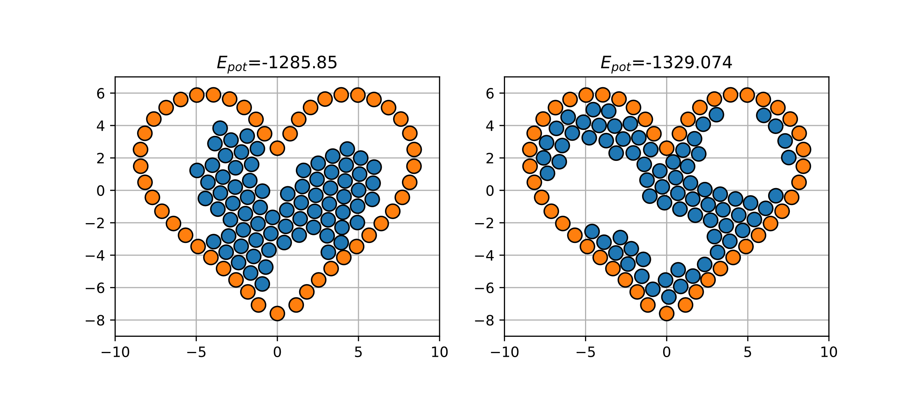
Exercise 28 – Simulated annealing
Finite simulation time

